Slide 1
How to test eIDAS

Slide 2
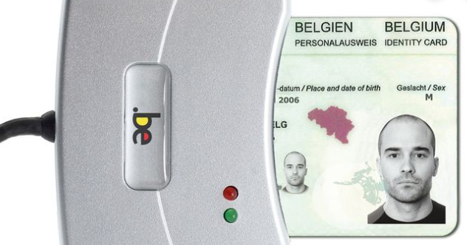
How to test eIDAS in the INT environment
We have created a new country “Test”
You can log on to this country with your own eID card
… but your request will be handled via eIDAS as with other countries,
this means you need to link your login to a BIS or a RRN number in Belgium
FAS QA environment
FAS INT environment
eIDAS protocol
eGov application
Jean Dupuis
Born 19/01/1970
Eidasjean Dupuis
70411914770
BIS number of Eidasjean Dupuis
70411914770

Slide 3
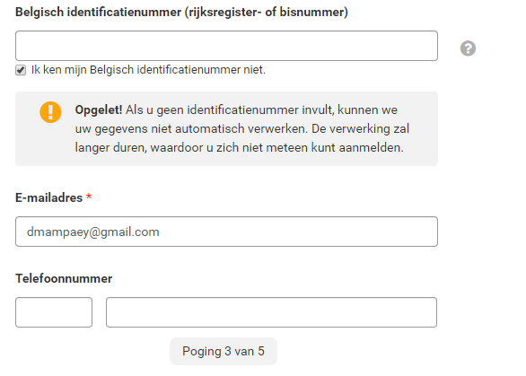
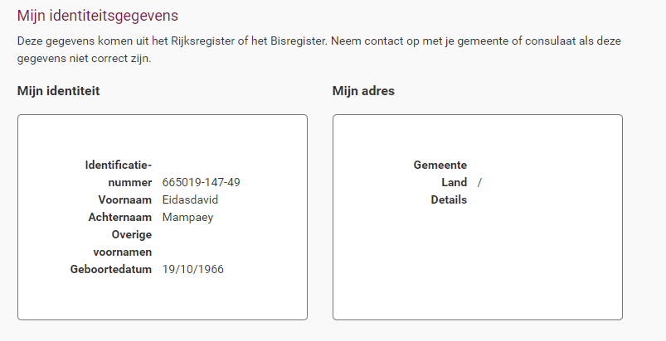
How to test eidas in the INT environment
1. Register yourself as a person with a foreign eID card via https://iamapps.int.belgium.be/sma
(INT environment) log in to SMA
(QA environment)
2. Request BOSA DGDT to create a BIS number in the INT environment for you
Tip: Ask to create a fictive name such as “Eidasjean Dupuis” and BOSA will link it to the eidas login in step 1
Send this request to Servicedesk.dto@bosa.fgov.be, also be sure to give your full name and your RRN.
3. Log in with your eID card to the application you would like to test
for example:
https://mycitizenebox.int.belgium.be/myebox/
https://iamapps.int.belgium.be/sma

Slide 4
After registration experience with eBox

Slide 5
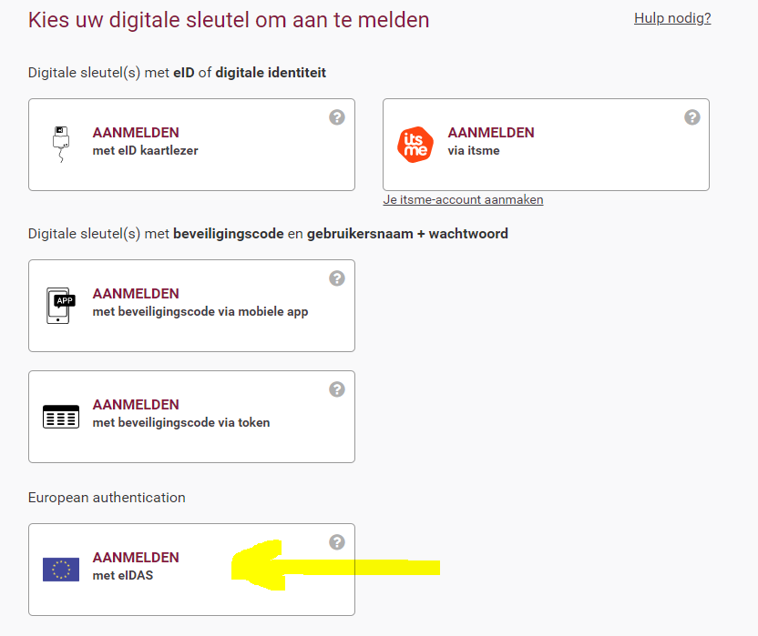
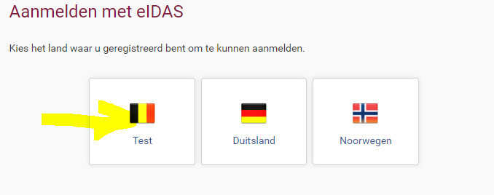
Login via eIDAS with “test” country

Slide 6
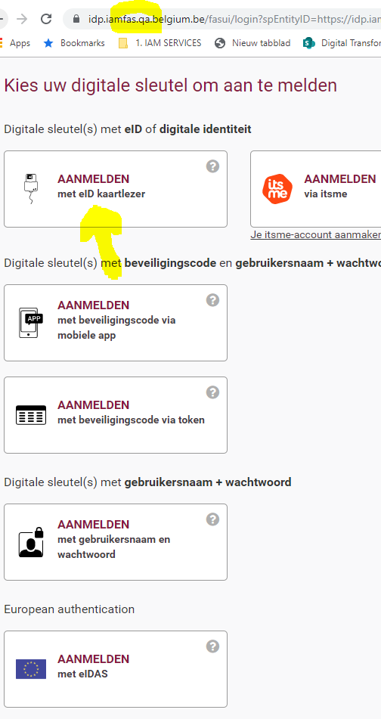
Log in QA environment representing the “test” country, using your eID

Slide 7
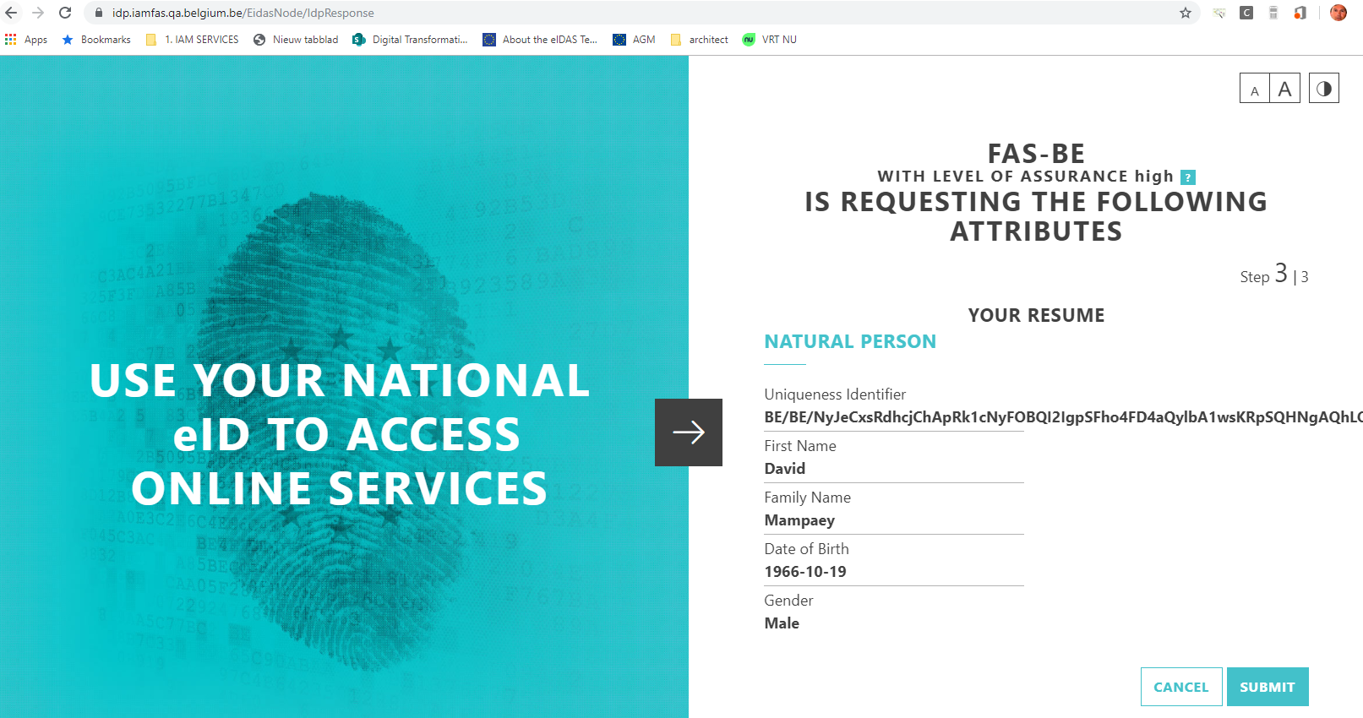
Confirm it is you

Slide 8
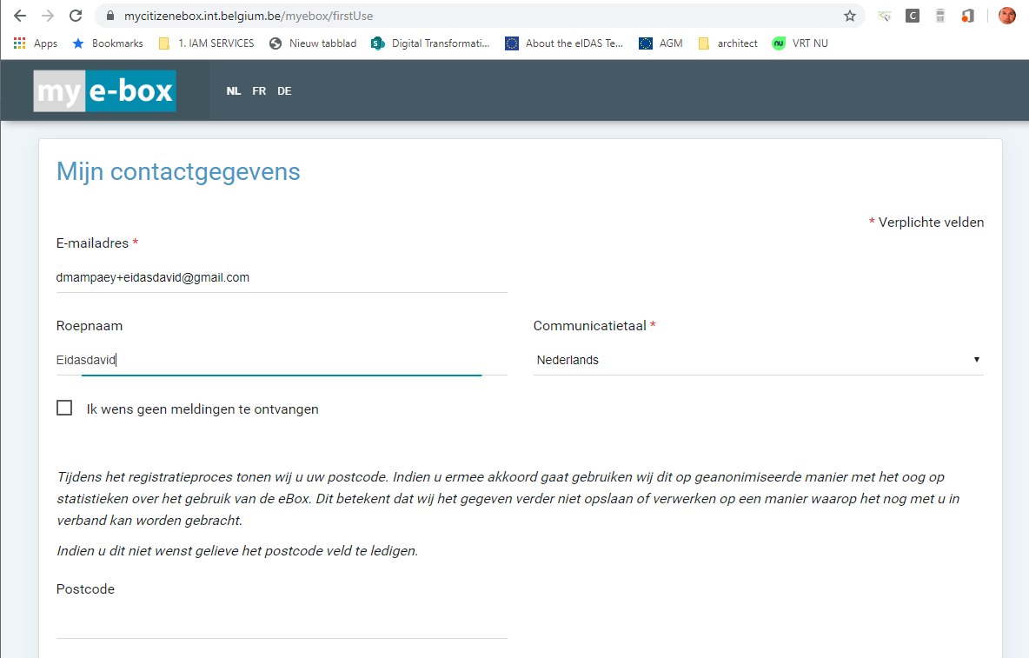
Give consent to eBox

Slide 9
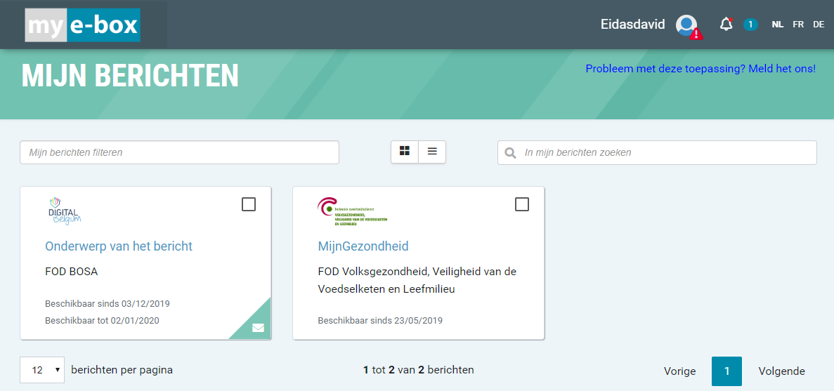
Access to the eBox via eIDAS

